Slide 1
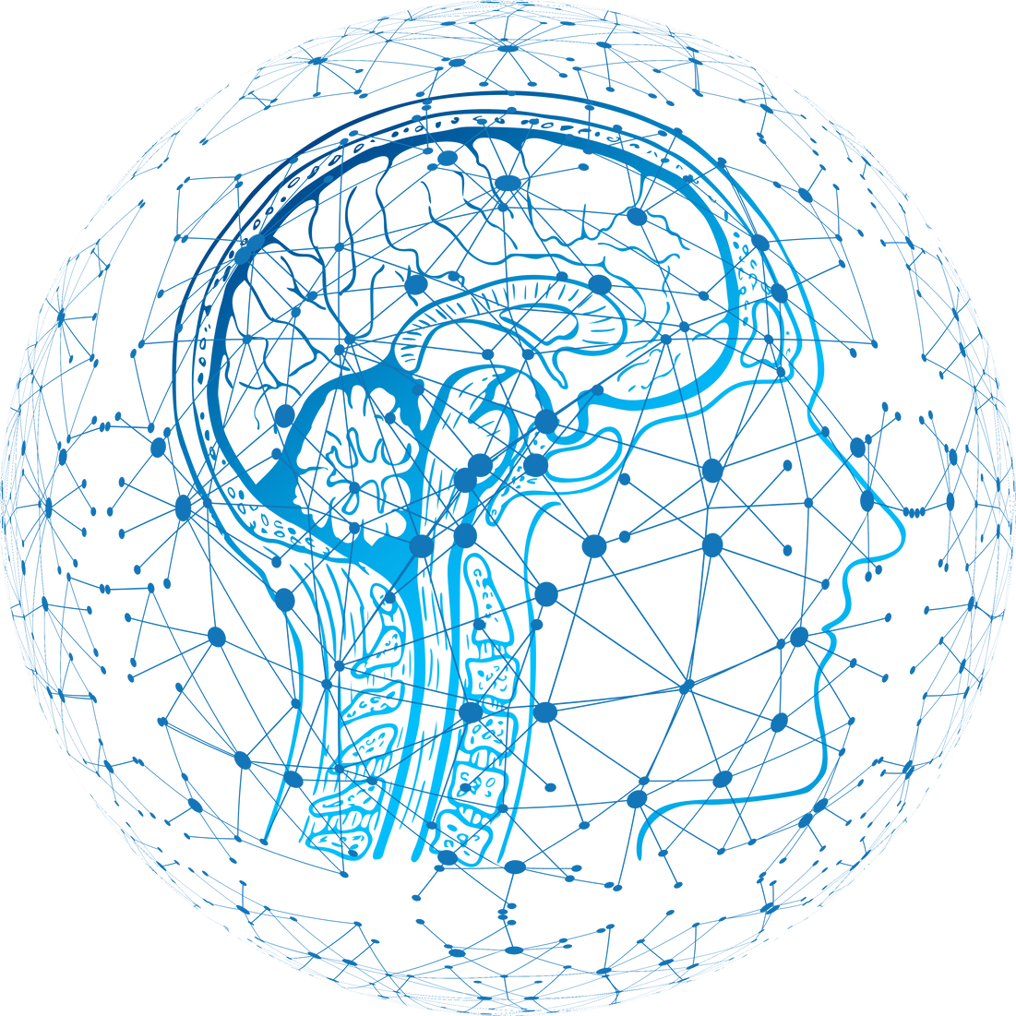
Machine Learning Project
AI-Based Autism Diagnosis System for Children
Prepared by:Hala Mohammed, Raghad Al-Sayed Ahmad, Ahmad Fahoum
Instructor: Dr. Adnan Yahya
01

Slide 2
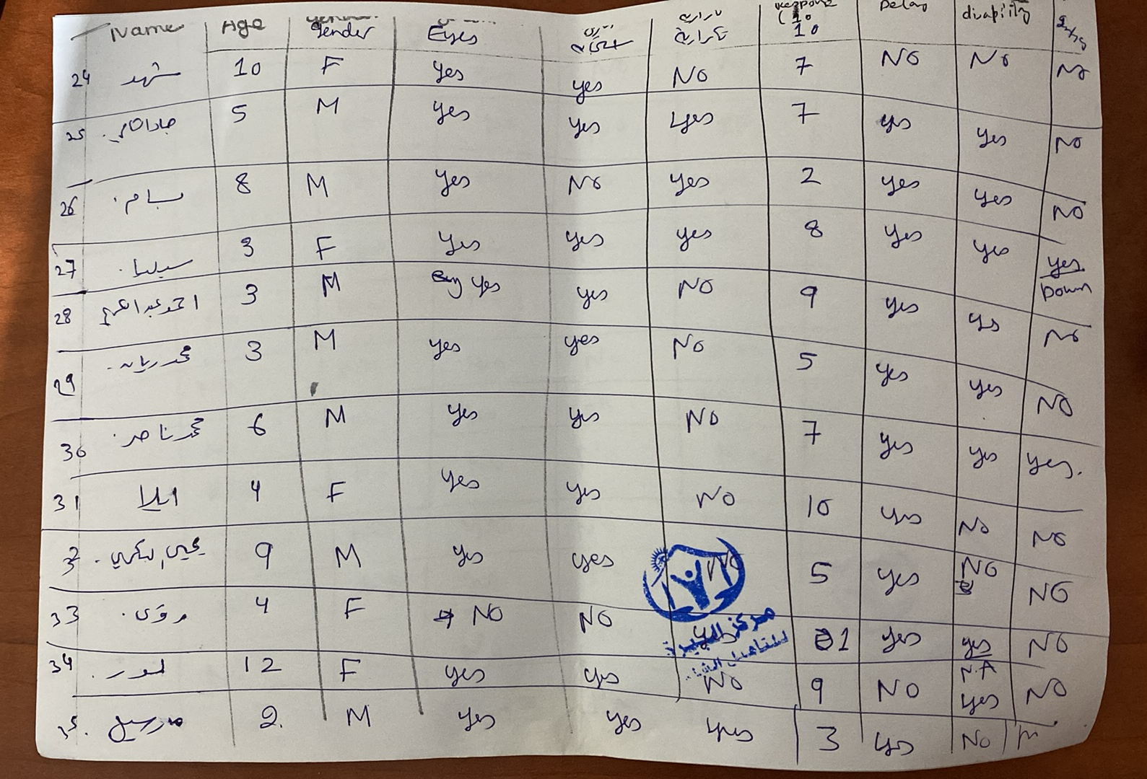
Data Collection Process
-A visit to the Comprehensive Rehabilitation and Speech Therapy Center was conducted.
-Real Data was manually collected due to the center's lack of a formal database.
-Observations included:
1-Behavioral patterns (eye contact, social interaction, repetitive behaviors).
2-Responses to auditory and visual stimuli.
3-Developmental milestones in language and cognition.
02

Slide 3


Implementation Details
We used two approaches to implement the algorithms:
1.Weka:
-Faster testing of algorithms.
-Quickly compares performance metrics (e.g., precision, recall).
2-Python:
-Allows the creation of a user-friendly interface.
-Enables users to test new cases and scenarios independently.
"We combined Weka for rapid testing and Python for customizability and user interaction, ensuring a balanced and efficient system."
03

Slide 4
Explanation:
Real data was collected and named 'Real Data'. Data was taken fromthe Internet and named 'Data_Internet '. Different algorithms were tested on these datasets, with the training and testing data being switched between them each time.
What we focused on to Compare:
Precision: How accurate the model's positive predictions are. Higher precisionmeans fewer FP.
Recall: How good the model is at finding all the actual positive cases. Higher recall means fewer FN. ➢
F-Measure: A score that balances precision and recall. ➢
Correctly Classified Instances: The percentage of cases the model got right. ➢
Incorrectly Classified Instances: The percentage of cases the model got wrong.
04

Slide 5
Analysis and Comparison:
01
The Best Algorithm:
02
The Next Best:
The Decision Tree is the most accurate overall, with the best combination of precision (78.7%), recall (75.2%), and F-measure (76.9%)It also correctly classifies 68.88% of the instances. and its Strengths is Offers a balanced performance with both strong precision and recall.
Naive Bayes ,holds its own with solid precision (69.7%), recall (69.1%), and an F-measure of 69.4%. It correctly classifies 62.54%of the instances. nd its Strengths is Simple and fast, making it a good choice for quickclassification tasks.
The Third Place:
The Lowest Performer:
03
04
KNN (K-Nearest Neighbors), it performs slightly below Naive Bayes, with a precision of 71.9% and recall of 60.4%, leading to an F-measure of 65.6%.It correctly classifies 57.93% of the instances.it Works well for small databut struggles here with the more complex dataset
ANN (Artificial Neural Network), it has a low precision (50.8%), meaning it misclassifies many negatives as positives. While it has a highrecall (93.8%), it results in a poor overall F-measure (65.9%).The fact that it possesses such a high level of recall guarantees that it is going to identify just about every positive case, and therefore at the moment, it is impractical given the complete lack of precision.
05

Slide 6
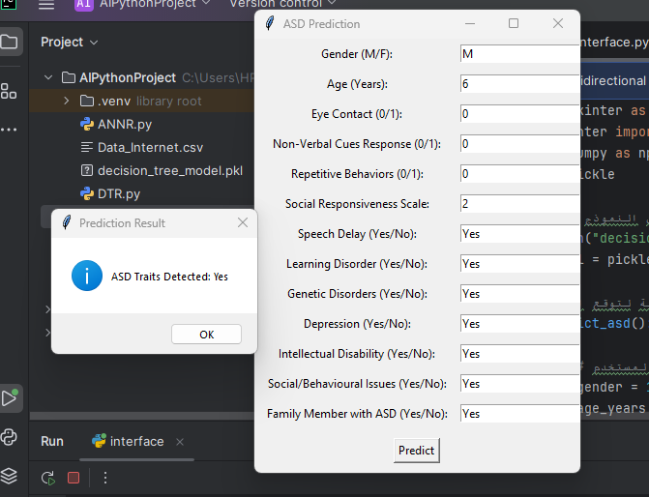
User Interface for Autism Diagnosis
Purpose:
Designed for healthcare professionals to input patient data and receive predictions.
Features:
-Inputs include critical diagnostic factors (e.g., eye contact, repetitive behaviors, social responsiveness).
-Predicts whether autism spectrum disorder (ASD) traits are detected based on a decision tree model.
Workflow:
User fills out patient information fields (e.g., gender, age, behavioral indicators).
Clicks "Predict" to receive instant results.
06

Slide 7
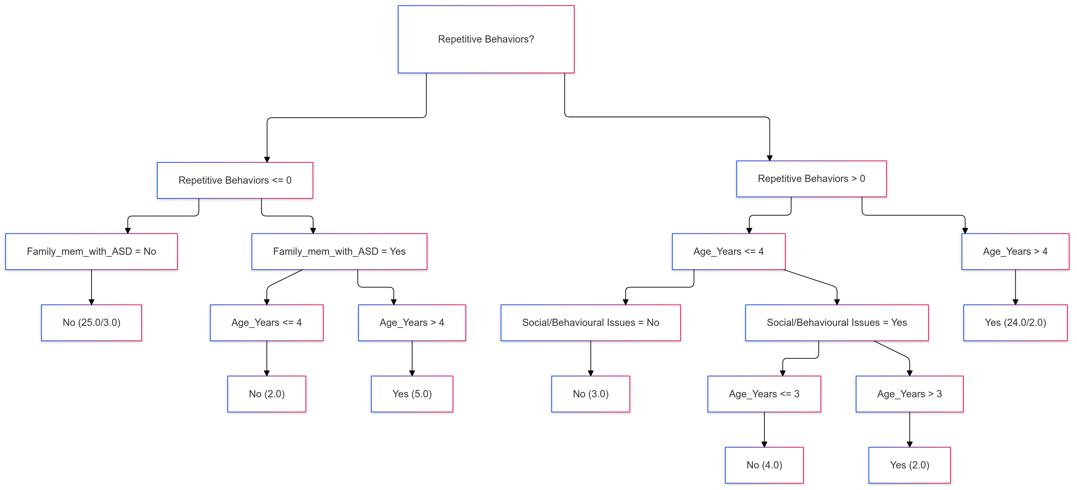
Decision Tree from weka for Real data as training and online data for train
07

Slide 8
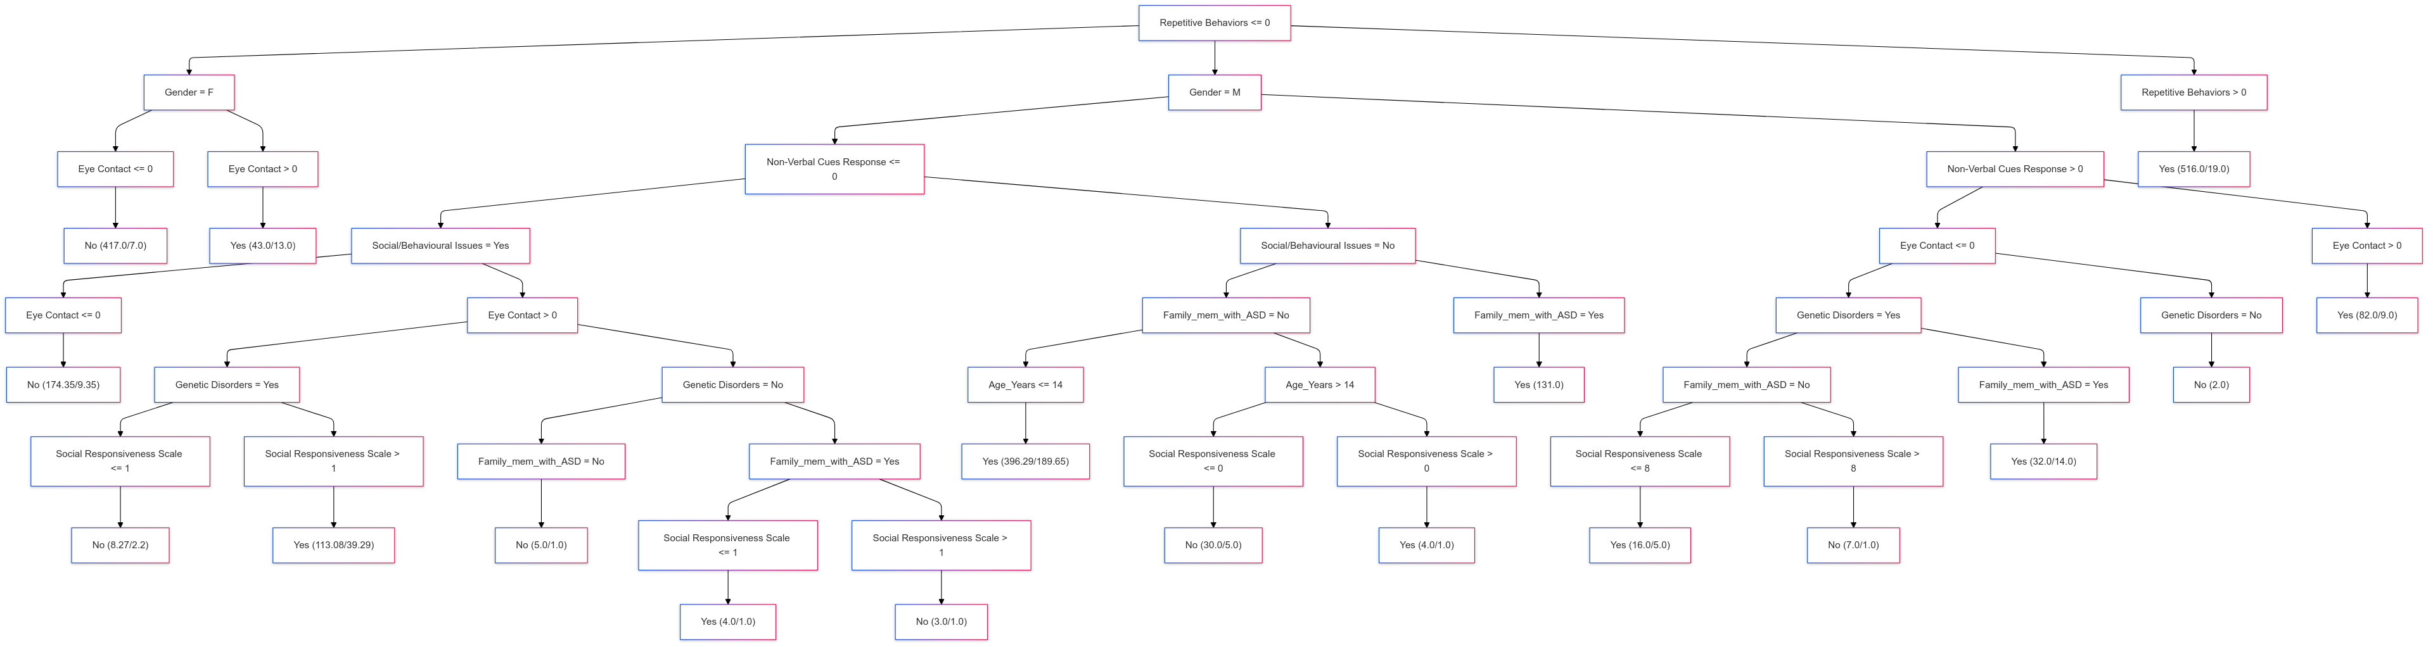
Decision Tree from weka for online data as training and Real data for train
08

Slide 9

The Final Results
Best choice: Decision Tree ➢
Worst choice: ANN (Artificial Neural Network)
09

Slide 10
The Conclusion:
The Decision Tree was the best algorithm, achieving 78.7% precision, 75.2% recall, and 76.9% F-measure, with 68.88% correct classification.
Naive Bayes performed well with 69.7% precision and 69.1% recall but was less effective than the Decision Tree.
KNN struggled with the dataset's complexity, resulting in lower accuracy.
ANN had high recall (93.8%) but very poor precision (50.8%), making it impractical.
10

